Slide 1

Exploring the Digital Playbook
Notes:
Add digital playbook education module #3

Slide 2
The Flow Through the Digital Delivery Lifecycle
Design with Users
Iterate and Improve Frequently
Work in the Open by Default
Use Open Standards and Solutions
Address Security and Privacy Risks
Ideation
Delivery
Discovery
Release
Build in Accessibility from the Start
Empower Staff to Deliver Better Services
Be Good Data Stewards
Design Ethical Services
Collaborate Widely

Slide 3
It all starts with an idea…

Slide 4
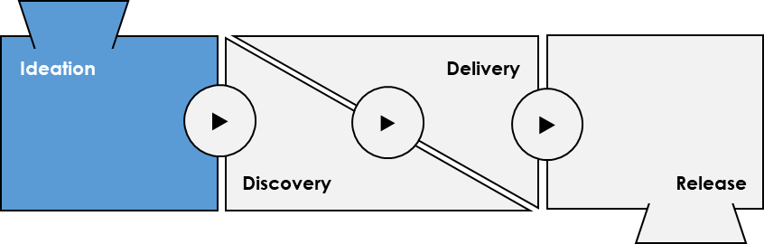
Ideation
Identify new problems or opportunities
Why?
Success
Stories
In order to innovate and empower a team to solve a challenge, we need to clearly define and understand the challenge and how you will measure success.
Validate
How?
Standards
Identify
Users
Define and frame the current problem or opportunity including key performance indicators (KPI), desired outcomes, and a documented vision.
Ideation
Who?
Product Vision
Program Stakeholders
Program Owner
Program SMEs
UX Designer
Product Owner
Business Analyst
Account Manager
Technical SMEs
Success Measures
Opportunity
Canvas

Slide 5
Examples
Inputs
Activities
Artifacts
Standards
Research
Opportunity Canvas
A one page business case that's kept up to date that frames the problem we're trying to solve.
Analytics
High-level User Personas
A user persona is a representation of a hypothesized group of users that will be using your product.
High-level Backlog
Initial listing of user stories and bugs for your product
Agile is easier with clearly defined architecture. Know, document, and share existing standards with team members.
Develop empathy for your users and their challenges.
Standards, Directives, and Policies
Analysis
Know and understand guidelines, directives, and policy.
Analyze data, trends, and research.
Success Stories
Ideation
Communicate and share success stories to help stimulate ideas, re-use, and acknowledge team successes.
Generate ideas to test.
Lessons Learned
Planning
Consult with lessons learned from similar governed projects.
Plan how to test the ideas generated.
Required

Slide 6
Frame Your New Idea With an Opportunity Canvas
The Opportunity Canvas helps facilitate structured discussions about your idea and allows all involved to better understand how the solution will generate value for users
Opportunity / Initiative
Key Metrics of Success
What has triggered the need for change?
How will you know the product has filled the market need?
User Segment
Key Partners
What is the addressable market segment?
Who are our key partners?
Alternative Providers
Key Activities
Evaluate product opportunities to ensure you are solving problems and creating true value.
Is this service being provided by others?
What key activities / milestones are associated with a successful launch?
Benefit / Price / Revenue
Key Resources
What is the desired outcome?
What are the key constraints in which the team is working within?
Increments of Value
Cost
What is the plan for how the product will be tested in the market?
What are the initial costs and ongoing expenses?

Slide 7
Building Your Opportunity Canvas
A One Page Business Case That is Kept Up-To-Date That Frames the Problems We Are Trying to Solve
Key Partners
Key Activities
Opportunity / Initiative
Key Metrics of Success
2
7
8
1
6
User Segment
Define the key partners (internal & external) and their level of involvement with the initiative.
Define the key activities associated to product development.
Define current user problems, as well as the organization’s vision and KPIs and the major features of a possible solution.
Define how you will be able to measure the success of the product.
Define the market you will find your users in and what channels they interact with.
Opportunity Canvas
Key Resources
5
9
Increments of Value
Define the resources required to achieve a successful launch of the product.
Problems
Capabilities
Define testable hypotheses that include metrics of success that answer whether or not hypotheses are correct.
User Segment
Place / Channel
10
Cost
4
Benefit / Price / Revenue
3
Alternative Providers
Iteratively define and refine costing of the initiative.
Define if this service is being provided by other levels of government or private sector and how ISED is positioned to differentiate.
Define the value and benefits that the product will bring to ISED users.

Slide 8

Exercise: Opportunity Canvas

Slide 9
Opportunity Shaping
Identifies capabilities, value propositions, and key risks; leads opportunity discovery and validation; Translates business and market needs to product requirements; defines and communicates vision
Voice of the Users
Gathers requirements from all users/business; develops insights into customer needs and wants; leads cross-functional teams to build capabilities to optimize user experiences at the story level
Backlog Prioritization and Management
Defines product features and clarifies their value to Business; writes product backlog; leads the epic / user story creation & development
Impediment Removal
Understands risks, issues, and blockers being experienced by teams and actively assists with issue resolution
Product Owner
Business Information Hub
Needs to be empowered by the business to make critical product decisions that are related to features, backlog prioritization, and release planning
Ceremony Participation
Attends planning sessions, stand-ups, retrospectives, sprint reviews to maintain close interaction with teams to ensure alignment on vision & value delivery
Value Verification
Frequently verifies that the work produced by teams realizes business value
Business Readiness Support
Supports technology leaders for implementation and change management in product rollout & enhancements
Timely Decision Making
Leads decision making & manages stakeholders at various levels to increase decision speed
Notes:
Talk about / re-introduce / reinforce product owner role/responsibility/critical player part of the team

Slide 10
How Will You Know Ideation is Ready to Transition?
You will know you are done when…
Required for Completion :
Product Owner identified
Considerations
Opportunity Canvas
If you can't measure it and track business value, why are you doing it?
There is active Ideation and passive Ideation. Active Ideation sees us proactively solicit ideas to make things better whereas passive Ideation waits for problems to surface via various channels.
You will also need to ensure design is aligned with the users and their goals in order to preserve a successful and accepted transformation.
Supporting Artifacts :
High-Level User Personas
High-Level Initial Product Backlog

Slide 11
Questions?

Slide 12
Moving on up…

Slide 13
Transitioning Between Plays
Transition between plays of the Digital Playbook
Ideation
Delivery
▶
▶
▶
Discovery
Release

Slide 14
Challenge and validate your assumptions…

Slide 15
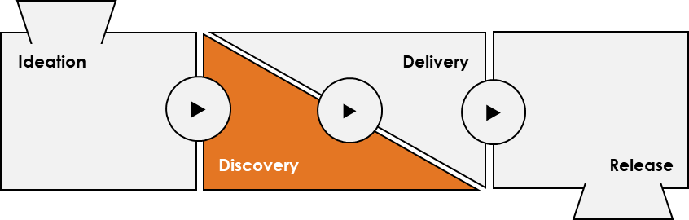
Discovery
Validate your ideas
Why?
In Order to build the right product or service, we need to challenge and validate our assumptions.
Standards
How?
Opportunity Canvas
Validate
Story
Map
Discovery
Answer the question: What functionality can help us realize the desired outcomes?
During the Discovery Phase we will test and validate our assumptions to better understand how the product will be realized.
Who?
User
Stories
Design
Validated
Product
Backlog
Program Stakeholders
Program Owner
Program SMEs
UX Designer
UI Designer
UX Researcher
Users
Product Owner
Scrum Master
Business Analyst
Scrum Lead
Technical SMEs
DPMO (Governance)
Define
MVR

Slide 16
Examples
Inputs
Activities
Artifacts
Opportunity Canvas
A one page business case that's kept up to date that frames the problem we're trying to solve.
Analytics
High-level User Personas
A user persona is a representation of a hypothesized group of users that will be using your product.
High-level Backlog
Initial listing of user stories and bugs for your product
User Research
Focusing on understanding user behaviors, needs, and motivations through observation techniques, task analysis, and other feedback methodologies.
Prototyping
Design and Validation
Prioritization and Refinement
Prioritized & Validated Product Backlog
This is the entire collection of user stories and bugs for your product
User Stories
A short description of product functionality
Story Maps
Story mapping is a collaborative activity that captures the journey your users will take within the application you are building.
User Personas
A user persona is a representation of a hypothesized group of users that will be using your product.
Prototypes
A prototype is an early module built to confirm a concept or process.
MVR KPI
Establish criteria and metrics, both qualitative and quantitative to measure the success and value of your Minimum Viable Release.
Required

Slide 17
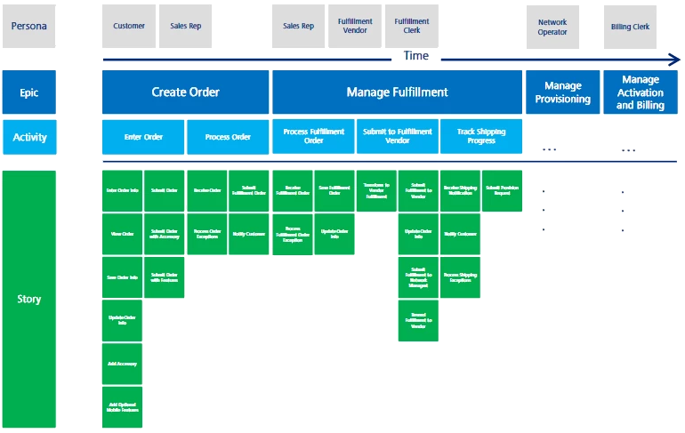
Story Mapping
Order User Stories to illustrate a user’s experience through your product
What is Story Mapping?
Story Mapping consists of ordering your user stories along two independent dimensions. Your map should arrange user activities or steps along the horizontal axis in a rough order. The vertical axis should contain the details in increasing complexity and sophistication of the requirement.
Why should I Make One?
A key benefit of Story Mapping is avoid failure with incremental delivery. The Story Map can help prevent the release of a product composed of features that deliver high business value but are unusable due to being functionally dependent on features deferred to future releases.
Story Mapping
Building Your Story Map
Tell a story
Group and define activities
Test for gaps
Prioritize
Define interactions

Slide 18
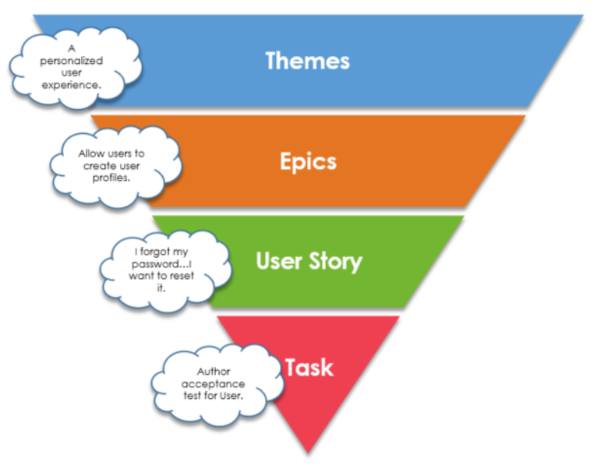
Product Backlog
This is the entire backlog of user stories and bugs for your product
This Is The Entire Backlog of User Stories and Bugs for Your Product
Keeping the Backlog Healthy – A Team Responsibility
The product backlog consist of all the user stories that make the functionality for the entire product that is being built
The product backlog is broken down into consumable components (Themes, Epics, User Stories, and Task)
The owner of the product backlog is the product owner.
The development team doesn't work through the backlog at the product owner's pace and the product owner isn't pushing work to the development team. Instead, the development team pulls work from the product backlog as there is capacity for it.
In other words, product owners dictate the priority of work items in the backlog, while the development team dictates the velocity through the backlog.
While the product owner is tasked with prioritizing the backlog, it's not done in a vacuum. Effective product owners seek input and feedback from users, designers, and the development team to optimize everyone's workload and the product delivery.
Keeping the backlog healthy is a team effort. Regular reviews, "backlog grooming", during each sprint, helps the product owner and the scrum team organize priorities as feedback is received, requirements and estimates are refined.
Product Backlog

Slide 19
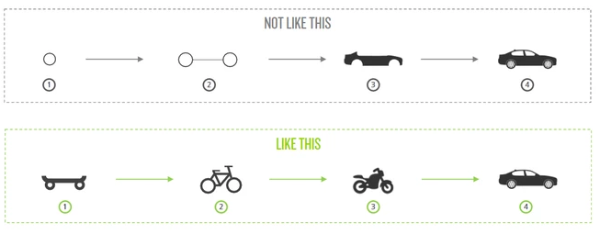
Minimum Viable Release
The minimum amount of features required to deliver value to users in order to learn
A Minimum Viable Release has just the core features that allow the product to be deployed. It is a strategy targeted at avoiding building products that customers do not want
Minimum Viable Releases allow a team to smartly identify their riskiest assumption, find the smallest possible experiment to test that assumption, and use the results of the experiment to course correct
Minimum Viable Release
Guiding Principles
Valid: Must meet the overall vision of the product/service for the business
Valuable: Must provide more value to the business and users than it costs to make
Viable: Must be doable within the allotted timeframe

Slide 20
Exercise:
Story Map

Slide 21
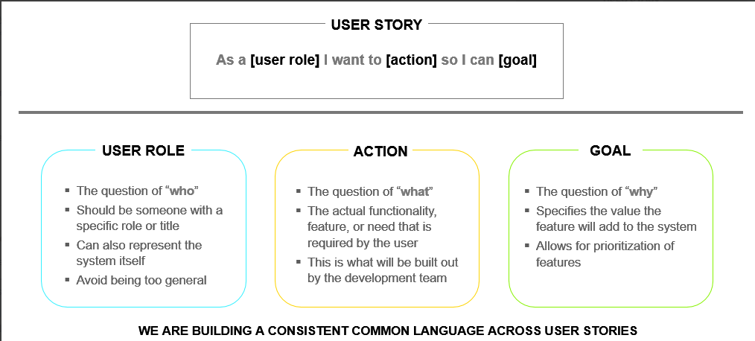
User Story
A user story is written from the perspective of the user and should be independent of each other
What?
A user story is a short description of the product functionality. The user story is written from the perspective of the user and usually written by the Business Analyst, Product Owner, or the Program Owner as they have first hand knowledge of the user needs and requirement.
User Story

Slide 22
User Story
Is my user story good enough?
Use the INVEST principles:
Independent - A story is structured to minimize dependencies
Negotiable - A story allows further refinement of scope to provide options around timing and cost
Valuable - A story has concrete business value or an inherent investment value
Estimable - A story has sufficient definition to enable coarse estimation
Small - A story is small enough to be completed within a sprint
Testable - A story is testable by itself and has clear acceptance criteria associated with it

Slide 23
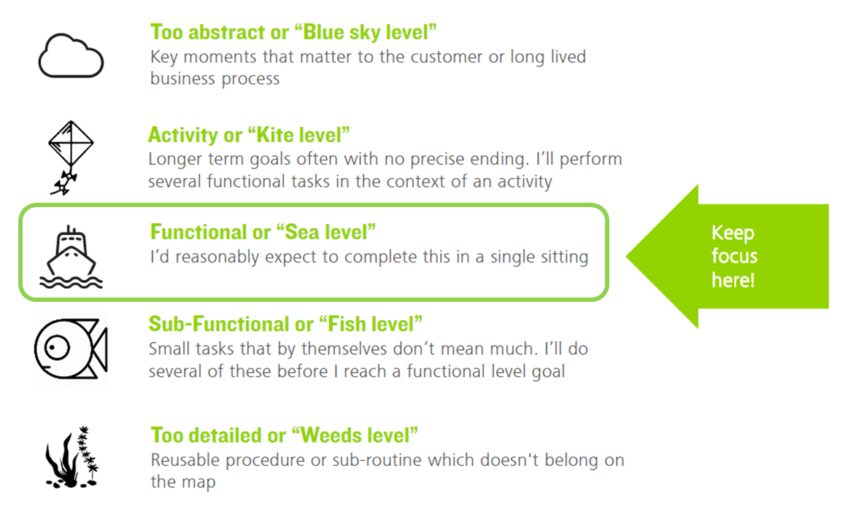
User Story
Let’s make the user story more usable: Acceptance Criteria
What?
Acceptance criteria brings clarity to the scrum team so they know how to build and complete the requested functionality within the user story. The acceptance criteria also clarifies how the user will use the product as well as their expectations.
Acceptance criteria may follow the below format:
GIVEN <context, user, etc.>
WHEN <action to be carried out>
THEN <expected result obtained>
Example
GIVEN I am a power user
WHEN I merge two user records and choose which values to keep from each record
THEN only one updated user record will be remain in the system

Slide 24
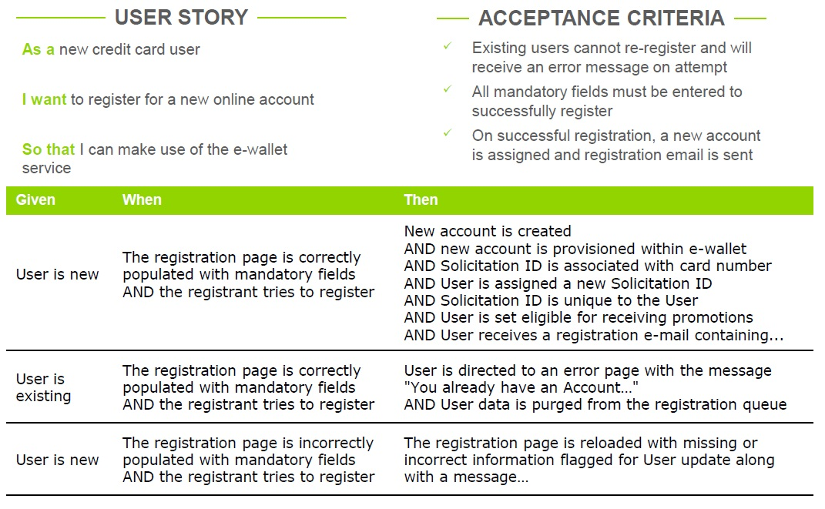
User Story
Example

Slide 25
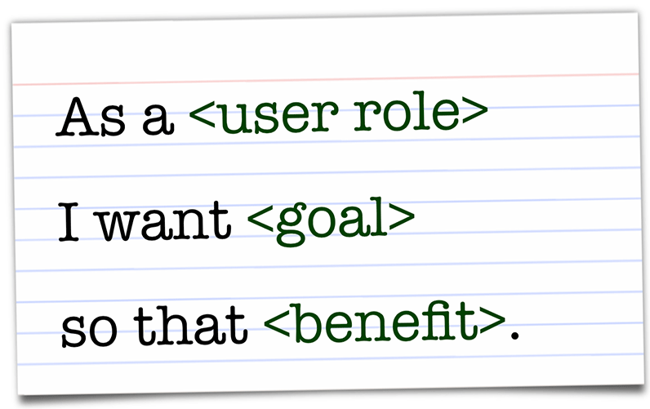

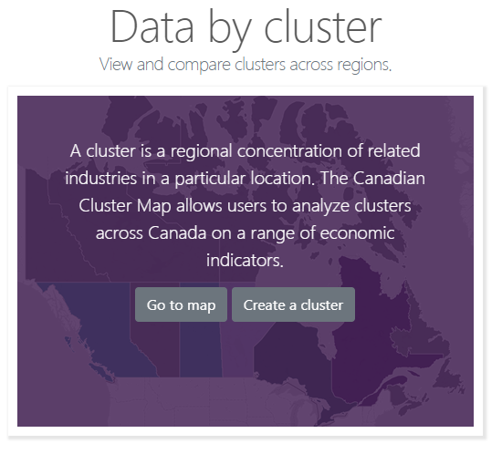
User Story
Definition of Ready (DoR)
The DoR for a user story is a set of specific agreed upon criteria for confirming that detailed user stories are Clear, Concise, Actionable & Ready for the scrum team to begin working with them.
Minimum Criteria
Story has been written in the “As a…I want to… so that” format
Acceptance Criteria has been defined for the story in objective & unambiguous language and therefore testable
Story dependencies have been minimized and, where possible, eradicated
The scrum team agrees that the user story contains enough detail to estimate it
Detailed user story is able to be assigned to a future sprint and release
Recommended Criteria
Internal business partners / functions affected by the user story have been identified and tagged
Where available, business rules are included and any supporting documentation (e.g., process flows; prototype) is referenced
Business value has been quantified
Notes:
The idea of the Definition of Done (DoD) as part of Delivery, should be discussed here, and fleshed out in the Transition Between Plays section.

Slide 26
Business Requirements and User Needs
Finding the Balance
User needs and expectations
Business requirements
What the User Wants
Legislation /
Mandate

Slide 27
Use Case vs User Story
Use Case
A use case describes a sequence of actions a system performs resulting in observable value to a particular user,
Navigate to the register landing page
Enter email address
Create a new password
Enter the password again in a separate field…
User Story
A user story is a short description of the product functionality, and is written from the perspective of the user
As a new credit card user, I want to register for a new online account so I can make use of the e-wallet service
Rather than one person working on use cases at the beginning, the team works together to clarify and satisfy all the story requirements throughout the lifecycle of the project.

Slide 28
Questions?

Slide 29
Exercise: Write a User Story

Slide 30
User Story Example

Slide 31
How Will You Know Discovery is Ready to Transition?
You will know you are done when…
Required for Completion :
Prioritized & Validated Product Backlog
Considerations
User Stories
You will learn a lot during Discovery and additional ideas may come to you. The more you learn about your users, the better the product will be.
Maintain a full Product Backlog of what you would love to do…not just what you are constrained to do.
Supporting Artifacts :
Updated User Personas
A Minimum Viable Release has been defined

Slide 32
Moving on Up… Again…

Slide 33
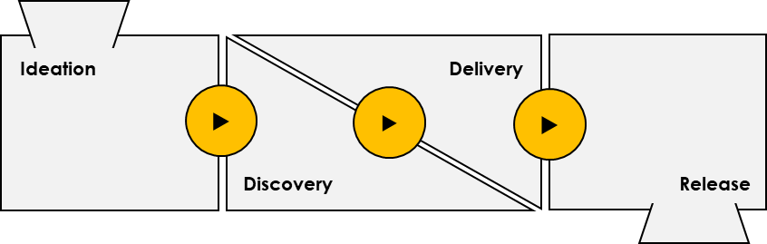
Transitioning Between Plays
Transition between plays of the Digital Playbook
Why?
The transition period is designed to shift work out of a completed play and into the next play in the Digital Playbook.
During this time the current project situation is evaluated by all participants to confirm that work on the previous play’s artifacts has met the Definition of Done (DoD) and how they will help transition into the next play.
Product
Backlog
Procure
Transition
Activities
Workplace
How?
The transition could be completed in a one hour meeting or it may take an entire day or week, depending on a number of factors that include the size of the project, the number of people, and teams working on the play.
Team
Working Agreement
Constraints
Who?
Product Owner
Program SMEs
Scrum Master
Scrum Lead
Technical SMEs
Scrum Team

Slide 34
How?
Workflow of a Transition Play
1. Overview
3. Schedule
The product owner reaffirms the product vison and shares the current status (plays complete, solutions released, teams in flight, etc...)
Based on the play, required activities, and available teams, the Release Manager schedules the work and resources. Also, depending on the play, the Release Manager will need to determine if resources will have to be removed from or added to scrum teams. Where required, team augmentation should be considered. As mentioned earlier, the team working agreement is an important part of the resource / team planning and will help shape new teams and or updated teams.
2. Evaluate
The transition participants evaluate their work against the definition of done to determine if they can begin to transition out of the play. Based on the play, part of the evaluation process will be to determine which activities, technologies, or tools may be required to successfully navigate the next play.
It is also important that as new teams are brought into each play, that a team working agreement is in place and agreed upon.

Slide 35
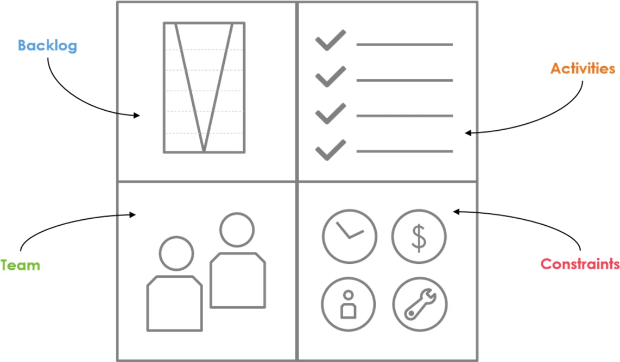
Transitioning Between Plays
Transition between stages of the Digital Playbook
During transitions, we document in a quadrant the scope to be undertaken in the next Play.
The quadrant consists of:
Backlog to be worked on,
Activities to be undertaken against that backlog,
The Team that will undertake the activities,
and any Constraints that the team will face.

Slide 36
Definition of Done (DoD)
During the Transition between Plays, the team must define and agree upon the definition of done for all of the activities that are going to be undertaken in the upcoming Play.
The DoD is a clear and concise checklist of requirements that must be met in order for the team to consider an activity complete.
The DoD changes over the life of a project and between plays, and should be revisited and reviewed during each Transition between Plays.
Product Backlog
-------------
-------------
-------------
-------------
-------------
-------------
-------------
-------------
-------------
-------------
-------------
Definition of Ready
ü-----------------
ü-----------------
ü-----------------
ü-----------------
ü-----------------
ü-----------------
ü-----------------
ü-----------------
ü-----------------
Definition of Done
ü-----------------
ü-----------------
ü-----------------
ü-----------------
ü-----------------
ü-----------------
ü-----------------
SPRINT

Slide 37
Working Agreement
Implement production ready capabilities
A working agreement establishes rules and disciplines that all scrum team members agree to adhere to throughout the entire process. Team members should hold each other accountable through the entire process and can use the sprint retrospective to reflect on the agreement and update if necessary.
Working Agreement
Examples of items found in a typical working agreement:
A list of scrum team members, the time they have allocated to the project, the team member's roles and responsibilities
When will the product owner be available and through which channels
What is the Definition of Ready for user stories
What is the Definition of Done for user stories
What ceremonies will be held, and where and when they will take place
What artifacts will be created, and how they will be shared with the team
What tools and processes will be used to manage the user stories, bugs, impediments, etc.
Definition of Done
---------------------------------------- □-------------------□ ------------------ □ ------------------ □ ------------------ □ ------------------ □ ------------------ □ ------------------ □ ------------------ □ ------------------ □ ------------------
Sprint Calendar
Scrum Team Roles & Responsibilities
------------------------------------------------------------------------------------------

Slide 38
Questions?

Slide 39
Exercise:
Transition Between Plays & Working Agreement

Slide 40
How Will You Know the Transition is Finished?
You will know you are done when…
Required for Completion :
Updated Working Agreement
Considerations
Consider reviewing project kick-off materials as part of the transition
Make sure to introduce and provide an overview of key stakeholders and their interests as this will keep the team(s) focused on the common goal
Supporting Artifacts :
Product Vision
Product Backlog
Release Plan

Slide 41
Build your idea, iteratively…

Slide 42
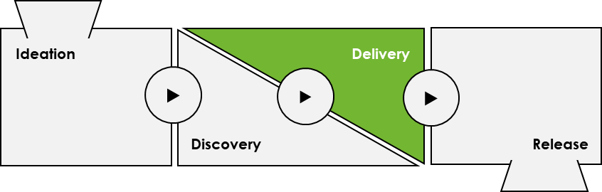
Delivery
Implement production ready capabilities
Why?
In order to reduce risk, we want to build in an iterative manner based on the highest priority items in the product backlog.
Validated
Product
Backlog
Validate
How?
Design
Delivery
In the delivery phase we will begin the iterative build process in order to deliver solution increments.
Develop Standards
Test
Who?
Build
Accepted
Product
Increment
Program Stakeholders
Program Owner
Program SMEs
UX Designer
Solution Architect
Developers
Users
Product Owner
Scrum Master
Tester
Scrum Lead
Technical SMEs
Communications
Standards

Slide 43
Examples
Inputs
Activities
Artifacts
Prioritized & Validated Product Backlog
Solution Design
Product Increment
This is the entire collection of user stories and bugs for your product
Confirming the technical architecture and application design of the product.
The Increment is the sum of all the Product Backlog items completed during a Sprint and the value of the increments of all previous Sprints.
Story Maps
Standards Review
Story mapping is a collaborative activity that captures the journey your users will take within the application you are building.
In this play, the team will be validating standards by confirming adherence to existing standards or setting new standards.
Release Plan
User Personas
Develop Proof of Concept
A release plan is a high-level expectation indicating when which features will be implemented/released and when they will be completed.
A user persona is a representation of a hypothesized group of users that will be using your product.
A proof of concept is a demonstration to verify that certain concepts or hypothesis are valid and can be achieved in development.
Test Cases
Each test case references a user story’s acceptance criteria and contains both the happy path and a negative testing scenario.
Prototypes
Development
A prototype is an early module built to confirm a concept or process.
For software projects, the team will be focused on designing and coding the application through a series of sprints.
Burndown Chart
Burndown charts are used by scrum teams to analyze and communicate the process of work that is occurring in their project
Product KPI
Unit & QA Testing
Establish criteria and metrics, both qualitative and quantitative to measure the success and value of your application.
Establish a test plan that outlines the approach and scope for all testing activities on the target application
Retrospectives
Retrospectives allow the team to reflect on how to become more effective and allow them to adjust and learn from past meetings
MVR KPI
Product Backlog Refinement
Establish criteria and metrics, both qualitative and quantitative to measure the success and value of your Minimum Viable Release.
Review, estimate and prioritize user stories in the backlog on a regular basis to make sure that the items at the top of the backlog are getting closer to the definition of ready.
Required

Slide 44
Agile Delivery
Leapfrog Approach
Define idea
Define Idea
Story Mapping
Epic 1:
G&C Intake
Epic 2:
Case Management
Epic 3:
Reporting
Epic 4:
Mobile
Epic 1:
G&C Intake
Epic 2:
Case Management
Epic 3:
Reporting
Epic 4:
Mobile
Epic 1:
G&C Intake
Epic 2:
Case Management
Epic 3:
Reporting
Epic 4:
Mobile

Slide 45
Video: Daily Stand-up
Notes:
https://www.youtube.com/watch?v=q_R9wQY4G5I

Slide 46
Definition of Done (DoD)
The DoD is a clear and concise list of requirements that a user story must satisfy for the team to consider it complete. It ensures that a story meets organization or project requirements, instead of only technical requirements.
Minimum Criteria
Acceptance Criteria is met
User story has been unit tested and passed
Where supported, Sonar code metrics have passed
All custom code has been peer reviewed
All code is completed and committed to code repository
Where required, deployment instructions updated in the Deployment to QA ticket
Ticket has been updated with the release version number
Ticket has been updated to reflect any changes that have occurred during development
User story has been tested and passed
User story has been demoed to the product owner and officially accepted. This happens during the Sprint Review ceremony
Functionality has been demonstrated and accepted by end users (e.g. usability testing)
Recommended Criteria
User documentation has been produced
Supporting documentation has been prepared such as training material and a change management plan

Slide 47
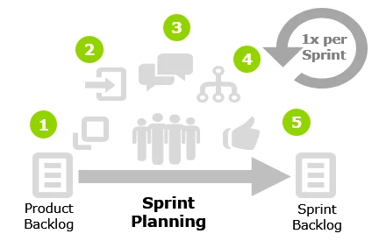
Sprint Planning
How?
1. Communicate:
Communicate team velocity, capacity and sprint objective.
For the first sprint planning ceremony the team will not know their capacity and this will not be accurately estimated until usually 3-4 sprints have been completed by the team.
2. Select:
Pull ready user stories into the sprint backlog
3. Clarify:
Ensure everyone understand the work being lined up for the sprint, and no major questions are unanswered
4. Estimation:
Break down each user story into a set of sub task to help manage work completion throughout the sprint. Optionally the tasks will be estimated by the scrum team and recorded in Jira
5. Align:
Do a final review and ensure all team members are on board with committing to the sprint backlog
What?
As a team review and confirm which user stories will be committed to the upcoming sprint. Breakdown down user stories into discrete sub-tasks.

Slide 48
Exercise: Sinking Islands
Notes:
http://tastycupcakes.org/2017/10/sinking-islands/

Slide 49
Sinking Islands
This activity is designed to help teams learn how to prioritize a list of backlog items and manage WIP
1
2
3
4
Text runs here
Text runs here
Text runs here
Text runs here
Identify backlog items that need prioritization. They are the islands.
Stand on the island that you think needs to be saved.
Select a representative for your island.
Each representative : describe why your island needs to be saved.
Stand on the island that you think needs to be saved.
Islands with the least amount of participants sink.
Islands with no participants sink.
Notes:
http://tastycupcakes.org/2017/10/sinking-islands/

Slide 50
Exercise: Planning Poker
Notes:
http://tastycupcakes.org/2009/06/planning-poker/

Slide 51
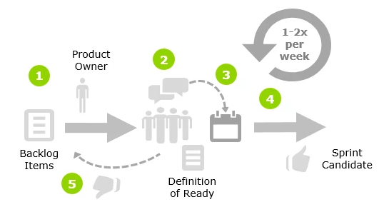
Product Backlog Refinement
How?
1. Prepare
The Product Owner prepares and prioritizes a set of User Stories from the Product Backlog to be reviewed by the team in order to ready them for the next few sprints
2. Discuss
The team discusses the User Stories and identifies any assumptions or clarifications necessary for the User Story to meet the Definition of Ready
3. Release Plan
As user stories are refined, added to the backlog and removed from the backlog, the release plan is also adjusted
4. Estimate
User Stories without major assumptions or clarifications required are sized and prioritized by the team
5. Revise
The Product Owner takes any actions identified to revise and update the Product Backlog
What?
Review user stories in the product backlog to ensure the backlog is prioritized, that the user stories have sufficient enough detail to estimate, and that the items at the top of the backlog are getting closer to the definition of ready or done.

Slide 52
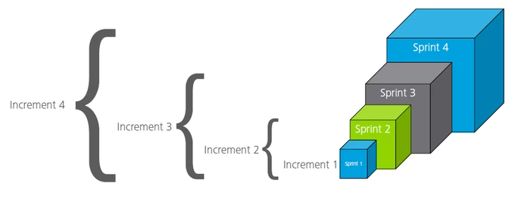
Product Increment
An increment of value that has been completed in the last Sprint and all previously delivered value
A Product Increment is the sum of all the Product Backlog items completed during a Sprint and the value of the increments of all previous Sprints
At the end of a Sprint, the new increment must be done. Which means it must be in useable condition and meet the Scrum Team’s Definition of Done
This means that the goal of each Sprint is to add incremental value to the product. It may take a number of Sprints and increments to build enough value to release the completed work
Product Increment

Slide 53
How Will You Know Delivery is Ready to Transition?
You will know you are done when…
Required for Completion :
Product Increment
Considerations
For major initiatives with a dedicated team, you can begin Delivery with the mundane things that are not controversial and may not require user testing.
Supporting Artifacts :
Delivery has more constraints than Discovery so careful planning needs to be done before starting, such as ensuring the right technical resource are secured for the selected architecture.
Refined Product Backlog
You have a Release Test Plan for the entire release

Slide 54
Moving on Out…

Slide 55
Transitioning Between Plays
Transition between plays of the Digital Playbook
Ideation
Delivery
▶
▶
▶
Discovery
Release
What would be done differently?
What would be the same?

Slide 56
Ready, set, launch!

Slide 57
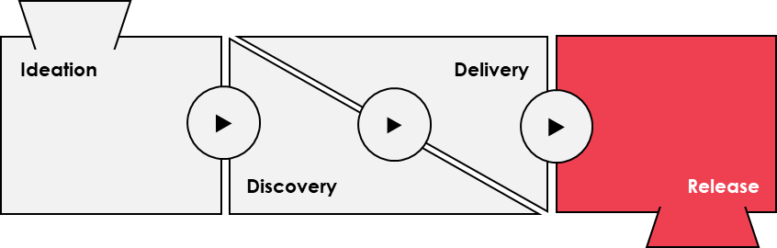
Release
Ready, set, launch!
Why?
As we're iteratively building, we need to have one final regression test to ensure everything works together and then we need to schedule and coordinate the release.
Product
Increments
Support
How?
Release
Test
In the release phase we will conduct testing, fix defects and bugs and deploy the final solution.
Launch
Who?
Program Stakeholders
Program Owner
Program SMEs
Developers
Users
Service Management
Organizational Change Management
Product
Release
Product Owner
Scrum Master
Tester
Scrum Lead
Technical SMEs
Communications
SSC
Deploy
Success
Stories

Slide 58
Examples
Inputs
Activities
Artifacts
Release Plan
Confirm release date
Training material
A release plan is a high-level expectation indicating when which features will be implemented/released and when they will be completed.
Test Cases
UAT Testing
Each test case references a user story’s acceptance criteria and contains both the happy path and a negative testing scenario.
Test Cases
Burndown Chart
Regression Testing
Burndown charts are used by scrum teams to analyze and communicate the process of work that is occurring in their project
Prioritized defect list
Retrospectives
Bug Fixing
Retrospectives allow the team to reflect on how to become more effective and allow them to adjust and learn from past meetings
Change Management Plan
Product Increment
Release Build to production
The Increment is the sum of all the Product Backlog items completed during a Sprint and the value of the increments of all previous Sprints.
Communications
Required

Slide 59
Product
A product is something that is created through a process and that provided benefits to a market
A Product is a tangible item produced to create specific value. A Product solves a problem or provides a benefit to the end user
Products can be defined recursively, where products can exist inside other Products. For example: an ink cartridge inside of a pen
Product
Remember…

Slide 60
How Will You Know Release is Finished?
You will know you are done when…
Your build has been verified across all environments and successfully deployed to production
Your regression defects have been addressed
Your communications have been set out
Your training material has been completed
Your maintenance transition meeting has occurred

Slide 61
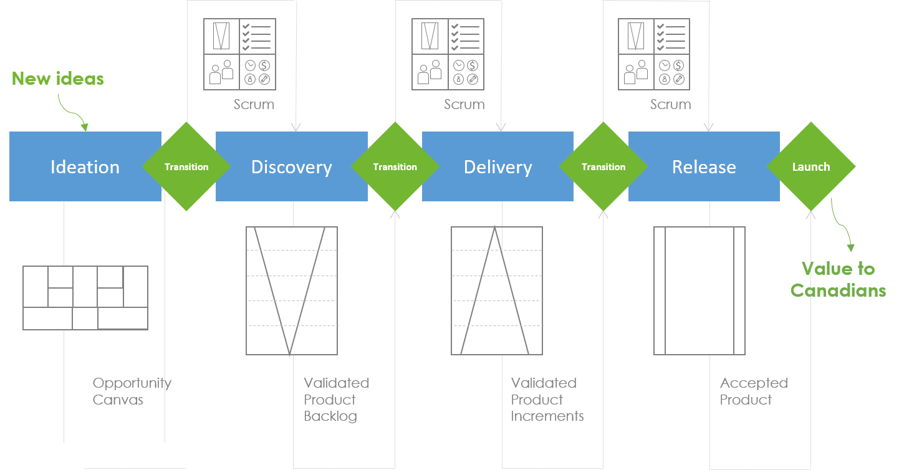
The Flow Through the Digital Playbook
Bringing it all together…
Start Ideation with new ideas and use an Opportunity Canvas to facilitate a structured discussion about the business problem or idea.
The idea is to learn during each iteration of Discovery. Use what you have learned and user research to create a Validated Product Backlog.
Start Delivery with the highest priority items from the Validated Product Backlog. Focus on designing and coding through a series of sprints in order to Validate Product Increments.
As we iteratively build, we need one final regression test to ensure everything works together. Then we need to schedule a Release of the Accepted Product.

Slide 62
Exercise: Course Retrospective

Slide 63
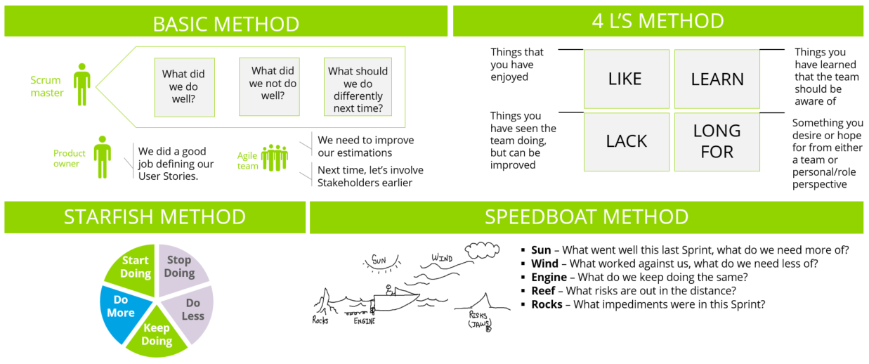

Slide 64
Appendix

Slide 65
The Digital Playbook
Success
Stories
Standards
Standards
Validate
Validate
Validate
Support
Identify
Users
Story
Map
Discovery
Design
Ideation
Delivery
Release
Test
Develop Standards
Launch
User
Stories
Test
Success Measures
Product Vision
Opportunity
Canvas
Design
Validated
Product
Backlog
Build
Accepted
Product
Increment
Product
Release
Deploy
Define
MVR
Standards
Success
Stories
Product
Backlog
Procure
Transition
Activities
Workplace
Team
Working Agreement
Constraints
Notes:
Start Ideation with new ideas and use an Opportunity Canvas to facilitate a structured discussion about the business problem or idea.
The idea is to learn during each iteration of Discovery. Use what you have learned and user research to create a Validated Product Backlog.
Start Delivery with the highest priority items from the Validated Product Backlog. Focus on designing and coding through a series of sprints in order to Validate Product Increments.
As we iteratively build, we need one final regression test to ensure everything works together. Then we need to schedule a Release of the Accepted Product.

Slide 66
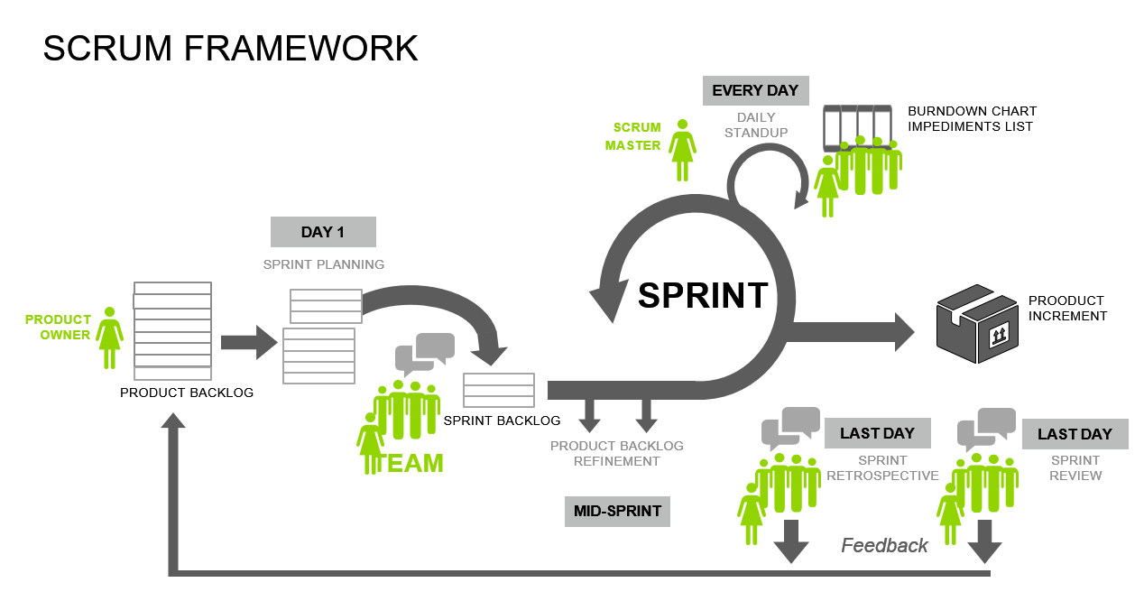

Slide 67
Start Asking Yourself the Right Questions
1
Opportunity / Initiative
2
4
Benefit / Price / Revenue
User Segment
3
Alternative Providers
5
Increments of Value
What has triggered the need for change (i.e. drivers for change)?
What problem are we trying to solve?
What is the business / users need this product is serving?
Is there a clear product value proposition?
What is the size of the opportunity?
What are potential solutions?
Is there a defined product to build?
Is the idea aligned to the organization’s mandate and strategic direction?
Is it meaningfully different from other ISED products?
What are the major features of our solution?
What is the addressable market / client segment?
What are the unique requirements of each client segment?
Who is the target client?
Is there a clear understanding of the gap (in the market)?
What is the anticipated market penetration?
What assumptions has the team made in determining the market need?
What is the relative fit of this product relative to other ISED products that serve this market?
Is this service being provided by others (levels of government / private sector)?
How would ISED be positioned?
What challenges or gaps must we deliver on to differentiate?
What is the desired outcome?
What is the total potential earnings or savings?
What is the anticipated impact on ISED operations?
What is the anticipated impact on ISED users?
What benefit are clients really willing to pay for?
What are the clients currently paying?
What will our clients pay?
What is the cost of not acting?
What is the plan for how the product will be tested in the market?
What market testing has been completed?
What assumptions has the team made in the product design?
As far as the team knows right now, what are some high-level design elements you are working with (e.g. security parameters, client expectations)?
How can value be realized earlier by thinking about the opportunity incrementally?

Slide 68
Start Asking Yourself the Right Questions (Cont’d)
6
Key Metrics of Success
7
9
10
Costs
Key Partners
8
Key Resources
Key Activities
How will you know the product has filled the market need?
What is the time frame of the cost-benefit analysis?
What would winning look like?
What are the key assumptions for product feasibility at this point?
What are the key performance indicators (KPIs) that will tell us how our product is doing?
Who are our key partners?
Which key resources are we acquiring from our partners?
Which key activities do our partners perform?
Who are our key suppliers / vendors?
Are there any dependencies this product has (e.g. technology capability)?
Are there any dependencies in achieving the milestones or outcomes identified?
What key activities / milestones are associated with a successful launch of the product?
Are there any ‘show-stoppers’ in the organization being able to implement (e.g. legal barriers)?
What are the key assumptions in moving forward?
Does the product meet ISED mandates?
Does the product meet legal / compliance requirements?
What does the team need most from the product sponsors?
What are the next steps to begin design, build & testing?
How will change be managed?
What are the risks or issues in developing and launching this product?
Risk assessment complete?
What are the key constraints in which the team is working within (e.g. time, skillset)?
Are there any implementation and capacity considerations?
What is the composition of the proposed team?
Who has what decisions rights and how will these resources will be managed?
What are the anticipated resource requirements - FTEs?
What key resources and capabilities does our product leverage for being successful in the market?
What are the initial costs and ongoing expenses?
What are the anticipated resource requirements - $?
How feasible is this product idea?
What are the most important costs drivers inherent in our product?
Which parts of our plan are most expensive?
What is the estimated overall cost and time to build and test the first MVR(s)?

Slide 69
Establish a Product Vision
The Product Vision describes the purpose of the product, the problem it is attempting to solve, and clearly articulates the positive benefits for the users of the product
Created and managed by the Product Owner and their team which could also include the Program Stakeholders
Important to understand the users that will be using the end product, how they will use it, and the value that they will get out of it
Research and prototyping activities can help shape the product vision
Highlights what is unique about the product
Defines the timeline and budget to launch the product
Should be clear and concise in a way that clearly communicates the product to the team
Product Vision

Slide 70
Activities Are Generated From the Product Backlog
Activities are generate from the Product Backlog
Activities
Activities Can Include:
Story Map
Journey Map
ISED Outreach
Technology Research
Develop User Stories
Prototype
Validate Prototype
A list of activities the team would like to conduct against the Product Backlog
In most instances, the activities act as a multiplier against the Product Backlog and determines the team and effort required to undertake the work

Slide 71
Scrum Teams Are Cross Functional and Skill Balanced
The assembled team takes responsibility for the work to be completed in each sprint
Team
Key Responsibilities
Commit to the team working agreement and adhere to the rules outlined
Attend all sprint ceremonies
Adhere to coding and testing standards
Breakdown user stories / requirements into tasks with completed estimates resulting in the spring backlog
Forecast the amount of work/scope they believe they can complete in each sprint
Ensure tasks status are updated in real-time and communicated to the team
Desired Outcomes
Based on team work the teams velocity should be consistent and predictable
Respect for each other ensuring that all team members have an equal say
Quality work focusing on producing value to the user
Peer reviews ensuring all team members are adhering to the agreed upon standards and guidelines
Responsible for delivering the agreed upon scope at the end of each sprint

Slide 72
A Constraint is a Restriction on the Degree of Freedom in Providing a Solution
The assembled team takes responsibility for the work to be completed in each sprint
Constraints
Example Constraints
$
Project budget of $200,000.00
Production deadline in six months
The team should work together to put together a list of constraints that they are bound to
Constraints can include time, budget, resources, tools, and external influences
Pressure from leadership to include certain features

